Slide 1
Learning Context-Sensitive Convolutional Filters for Text Processing
Dinghan Shen, Martin Renqiang Min, Yitong Li, Lawrence Carin
EMACL 2018
Liangming Feng
2018/10/19

Slide 2
Basic knowledge
CNN in NLP
Attention mechanism
Transposed convolution

Slide 3
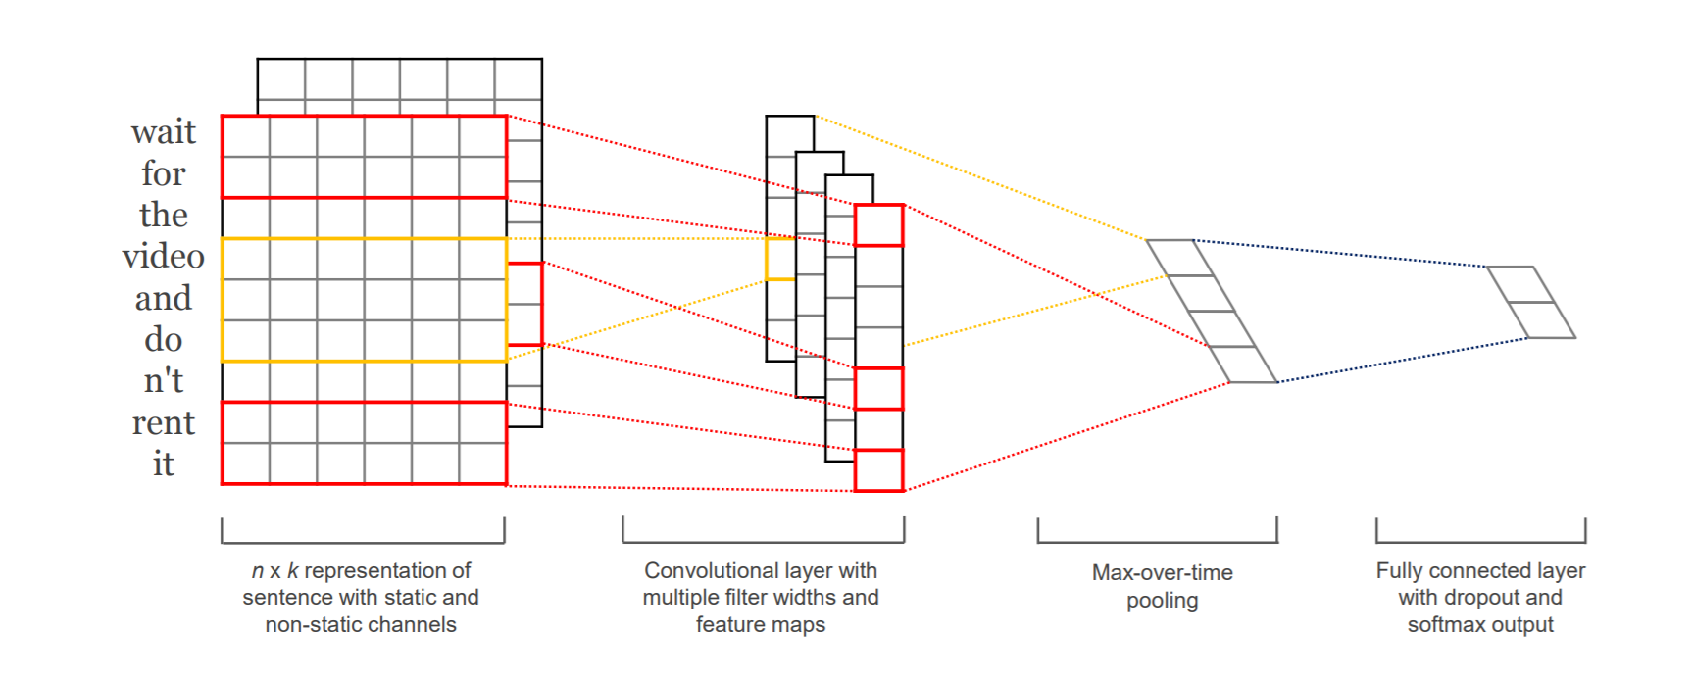
CNN in NLP
3-gram model
2-gram model
For input:
Word2vec embedding
Hidden states of RNN
No-static means tuning on word vectors
Yoon Kim. Convolutional Neural Networks for Sentence Classification.

Slide 4
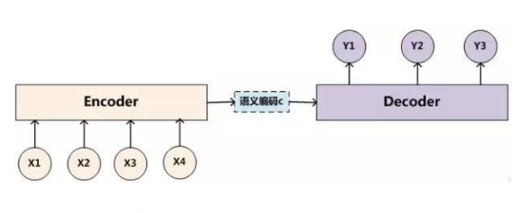
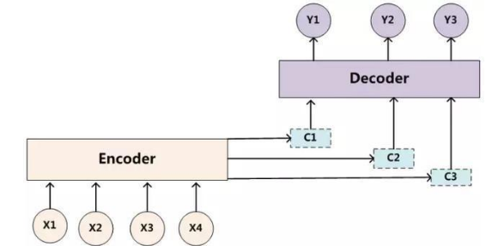
Attention
Y1 = F(C)
Y2 = F(C,Y1)
Y3 = F(C,Y1,Y2)
Y1 = F(C1)
Y2 = F(C2,Y1)
Y3 = F(C3,y1,Y2)

Slide 5
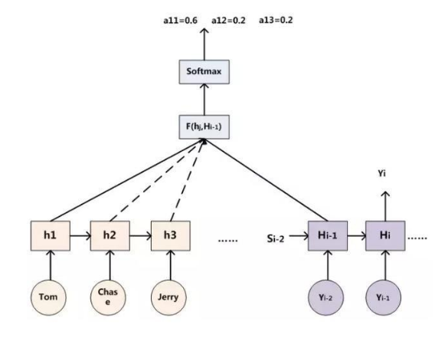
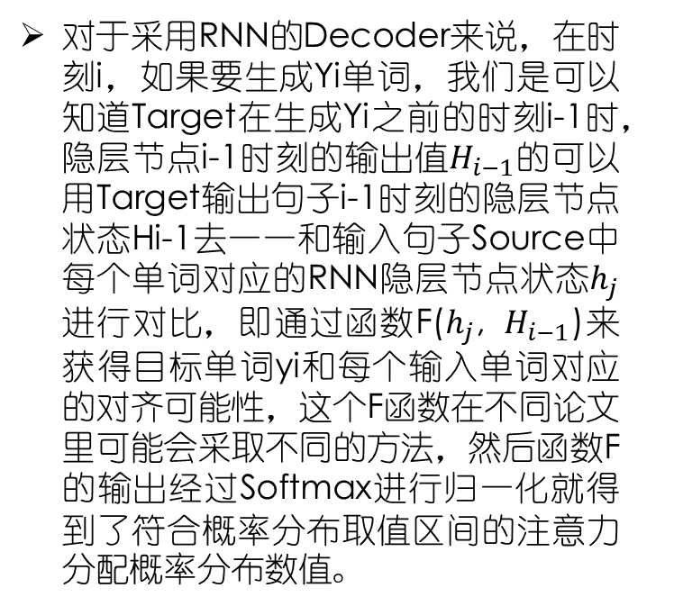
Attention
对于采用RNN的Decoder来说，在时刻i，如果要生成Yi单词，我们是可以知道Target在生成Yi之前的时刻i-1时，隐层节点i-1时刻的输出值$H_{i−1}$的可以用Target输出句子i-1时刻的隐层节点状态Hi-1去一一和输入句子Source中每个单词对应的RNN隐层节点状态$h_{j}$进行对比，即通过函数F($h_{j}$, $H_{i−1}$)来获得目标单词yi和每个输入单词对应的对齐可能性，这个F函数在不同论文里可能会采取不同的方法，然后函数F的输出经过Softmax进行归一化就得到了符合概率分布取值区间的注意力分配概率分布数值。

Slide 6
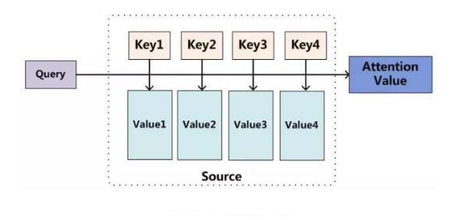
Attention
将Source中的构成元素想象成是由一系列的数据对构成，此时给定Target中的某个元素Query，通过计算Query和各个Key的相似性或者相关性，得到每个Key对应Value的权重系数，然后对Value进行加权求和，即得到了最终的Attention数值。所以本质上Attention机制是对Source中元素的Value值进行加权求和，而Query和Key用来计算对应Value的权重系数。
$$Similarity\left(Query,Source\right)=\sum_{i=1}^{l_{x}}{Similarity\left(Query,Key_{i}\right)∗Value_{i}}$$
Definition comes from：Vaswani A, Shazeer N, Parmar N, et al. Attention Is All You Need[J]. 2017.

Slide 7
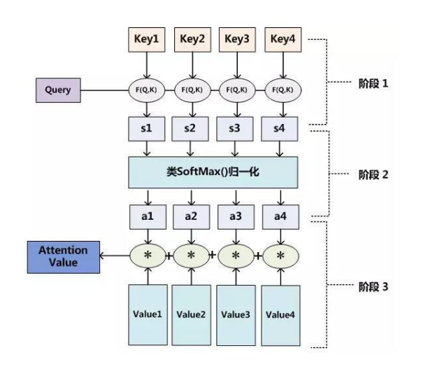
Attention
对目前大多数Attention计算方法进行抽象，可以将其归纳为两个过程：
第一个过程是根据Query和Key计算权重系数；
第二个过程根据权重系数对Value进行加权求和。
而第一个过程又可以细分为两个阶段：第一个阶段根据Query和Key计算两者的相似性或者相关性；第二个阶段对第一阶段的原始分值进行归一化处理；这样，可以将Attention的计算过程抽象为如右图所示的三个阶段。

Slide 8
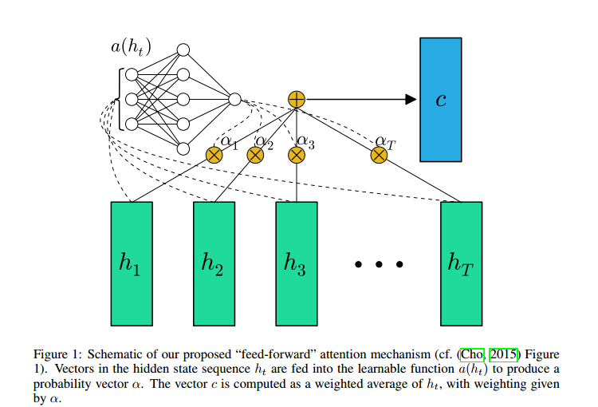
Attention-example1
Raffel C, Ellis D P W. Feed-Forward Networks with Attention Can Solve Some Long-Term Memory Problems[J]. ICLR 2016.

Slide 9
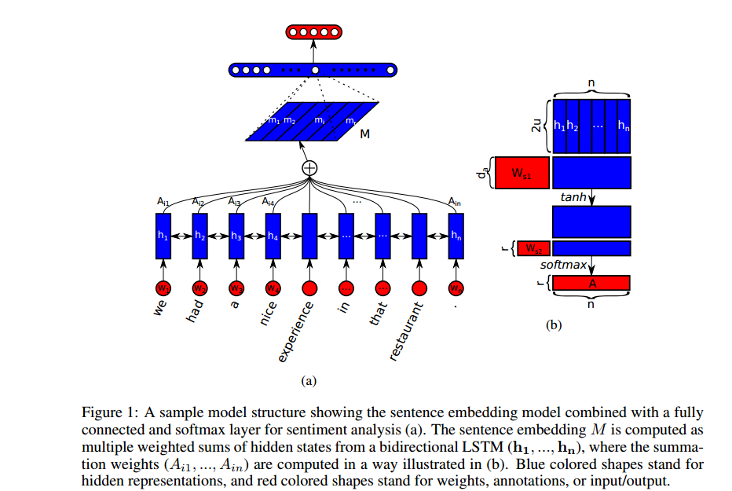
Attention – example2
Self-attention based model to get sentence representations,
Notice parameter in pic(b)
Lin Z, Feng M, Santos C N D, et al. A Structured Self-attentive Sentence Embedding[J]. ICLR 2017.

Slide 10
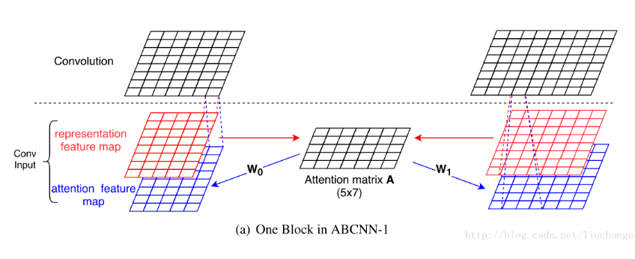
Attention – example3
Add a new feature channel
ABCNN-1
Yin W, Schütze H, Xiang B, et al. ABCNN: Attention-Based Convolutional Neural Network for Modeling Sentence Pairs[J]. Computer Science, 2015.

Slide 11
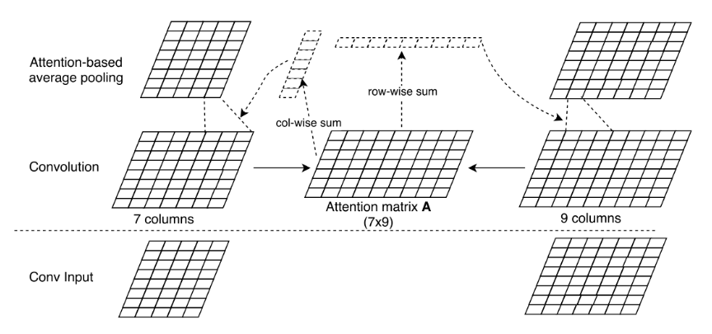
Attention – example3
Weighted Average Pooling
ABCNN-2
Yin W, Schütze H, Xiang B, et al. ABCNN: Attention-Based Convolutional Neural Network for Modeling Sentence Pairs[J]. Computer Science, 2015.

Slide 12


Transposed Convolution
$$WI=O$$
$$W^{T}O=I$$
Convolution:
I = 5, k = 3, s = 2, p = 1, o = 3
Transposed Convolution

Slide 13
Introduction
Most existing CNN models employed in NLP share the same learned (and static) set of filters for all input sentences.
Because of the fixed weights of filters, the rich contextual information inherent in natural language sequences may not be fully captured.
In fact, the context of a word tends to greatly influence its contribution to the final supervised tasks.
Several research efforts have sought to incorporate contextual information into CNNs to adaptively extract text representations. One common strategy is the attention mechanism(see ABCNN), which may contains more parameters and needs more computational operations.
The paper tries an approach of using a small meta network to learn context-sensitive convolutional filters for text processing.

Slide 14
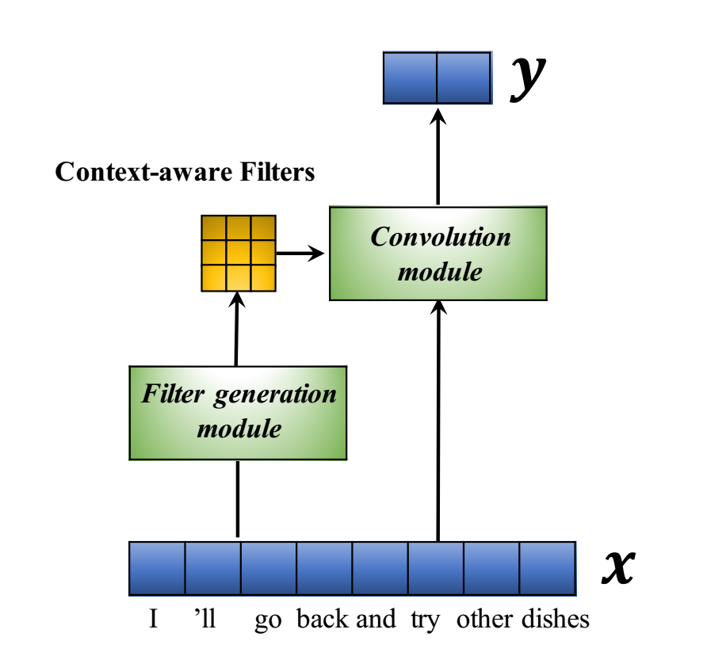
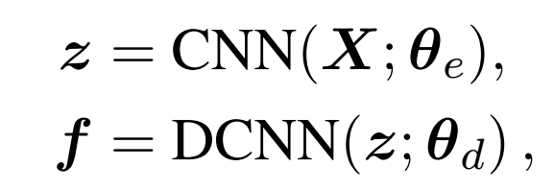
Model
Notably, there are no additional parameters in the adaptive convolution module (no bias term is employed).
Transposed convolution
X: n * k
z: L * 1
f: f * h * w

Slide 15
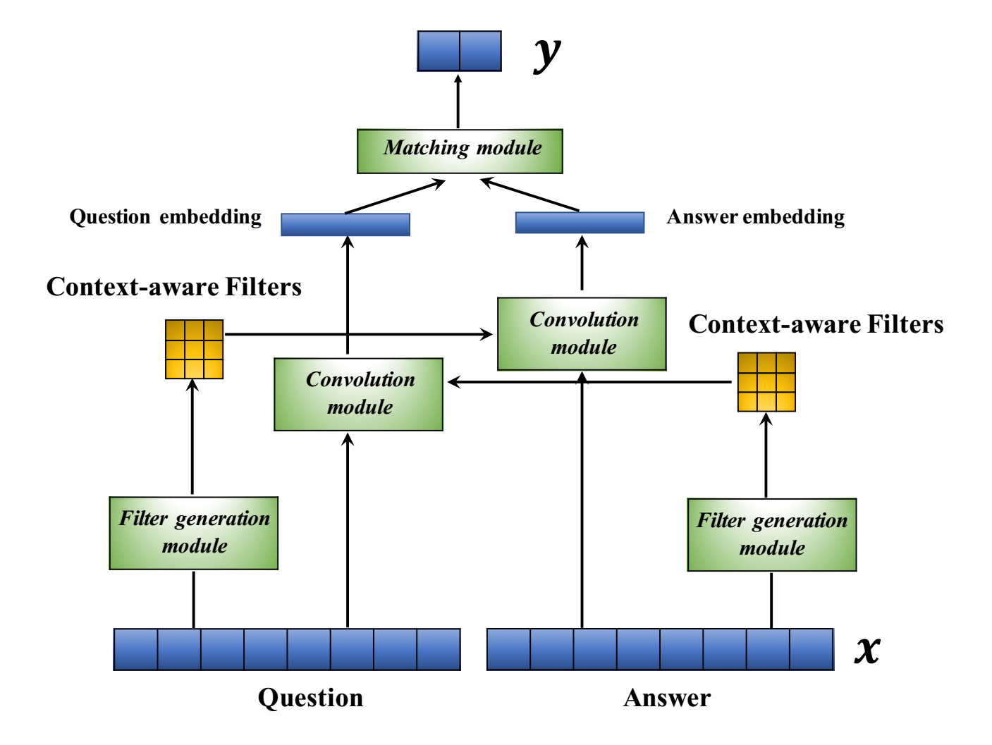
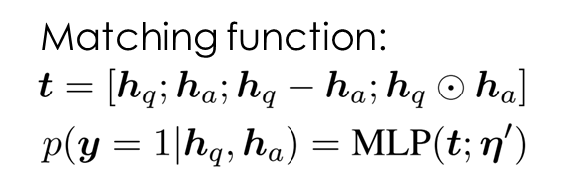
Extension to text sequence matching
Intend to incorporate rich contextual information into text representations which is similar to attention mechanism

Slide 16
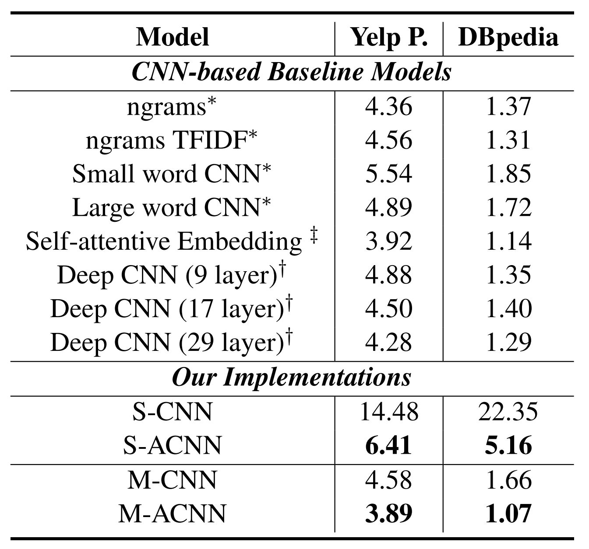
Experiment-Document Classification
For training details, look up the paper at section 4 “Training Details”

Slide 17
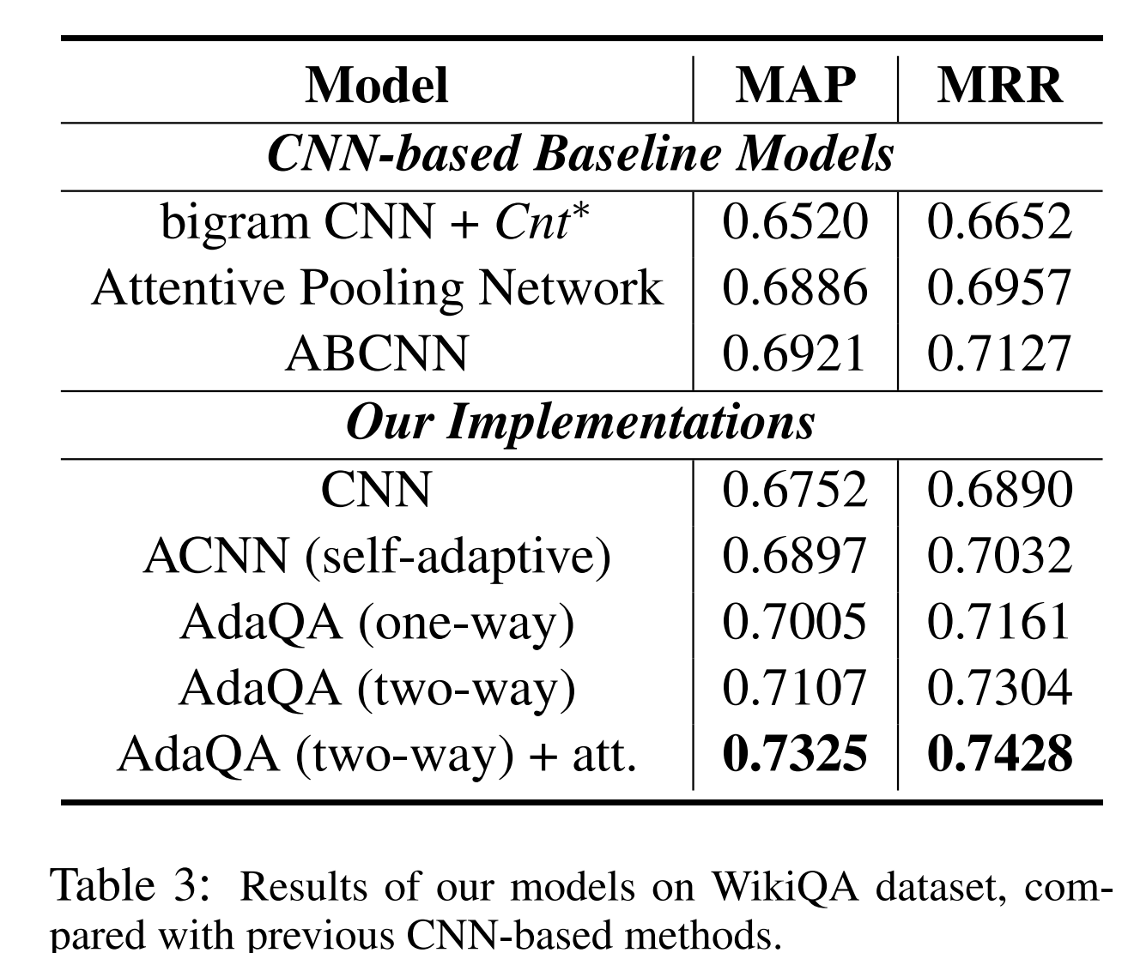
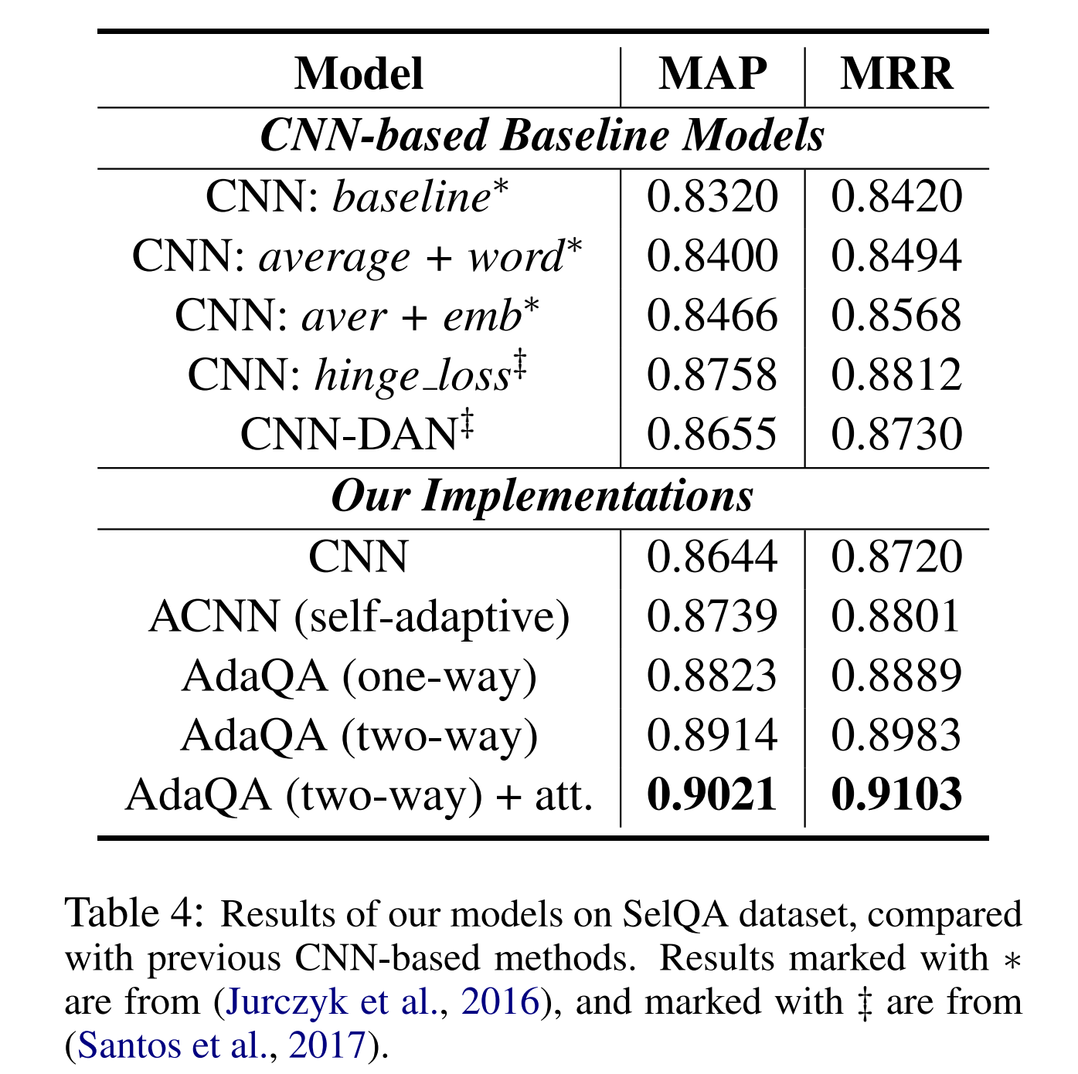
Experiment-Sequence Matching

Slide 18
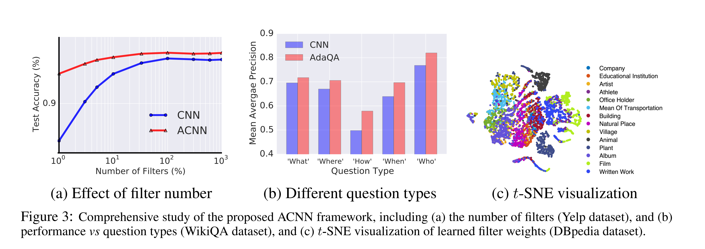
Study of ACNN’s framework
the filters for documents with the same label (ontology) are grouped into clusters, indicating that for different types of document, ACNN has leveraged distinct convolutional filters for better feature extraction
the boosted categorization accuracy does come from the improved flexibility and thus better feature extraction of our ACNN framework

Slide 19
Conclusion
We presented a context-sensitive convolutional filter generation mechanism, introducing a meta network to adaptively produce a set of input-aware filters. In this manner, the filter weights vary from sample to sample, providing the CNN encoder network with more modeling flexibility and capacity. This framework is further generalized to model question-answer sentence pairs, leveraging a two-way feature abstraction process. We evaluate our models on several document-categorization and sentence matching benchmarks, and they consistently outperform the standard CNN and attention based CNN baselines, demonstrating the effectiveness of our framework.

